Slide 1
Control Hazard

Slide 2
Outline
Control Hazard
Suggested Reading 4.5.9

Slide 3
Control Dependence
Example:
  loop:
  subl %edx, %ebx
  jne targ
  irmovl $10, %edx
  jmp loop
  targ:
  halt
The jne instruction create a control dependency
  Which instruction will be executed?
Notes:
这种dependency在SEQ和SEQ+中也是不存在的。道理和前面data dependency的道理相通。

Slide 4
Branch Misprediction Example
#demo-j.ys
0x000: xorl %eax,%eax
0x002: jne t # Not taken
0x007: irmovl $1, %eax # Fall through
0x00d: halt
0x00e: t: irmovl $2, %edx # Target (Should not execute)
0x014: irmovl $3, %ecx # Should not execute
0x019: irmovl $4, %edx # Should not execute
Should only execute first 4 instructions
Notes:
这是control dependency引起问题的一个例子。

Slide 5
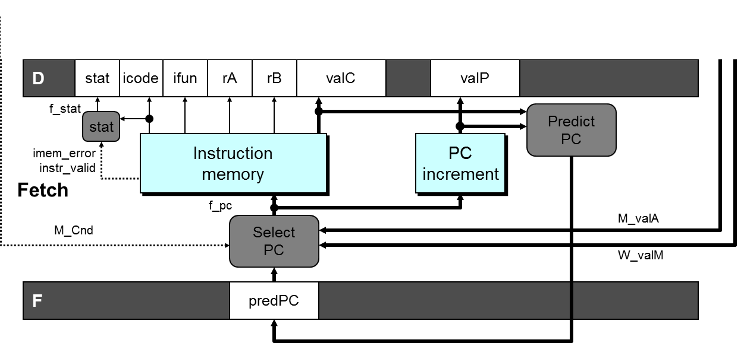
Select PC
int F_predPC = [
f_icode in {IJXX, ICALL} : f_valC;
1: f_valP;
];

Slide 6
Branch Misprediction Trace
1
2
3
4
5
6
7
8
9
1: 0x000: xorl %eax,%eax
2: 0x002: jne T # Not taken
3: 0x00e: irmovl $2, %edx # T
4: 0x014: irmovl $3, %ebx # T+1
F
D
E
M
W
F
D
E
M
W
F
D
E
M
W
F
D
E
M
W
F
F
D
D
E
E
M
M
W
W
# demo-j.ys
0x000: xorl %eax,%eax
0x002: jne T # Not taken
0x007: irmovl $1, %eax
0x00d: halt
0x00e: T:irmovl $2, %edx
0x014: irmovl $3, %ebx
0x01a: halt
Cycle 5
Memory
M_Cnd=0
M_valA=0x007
Excute
e_valE2
E_dstE=%edx
Decode
D
D_valC=3
D_dstE=%ebx
Incorrectly execute two instructions at branch target
Fetch
F
Notes:
在M中的是jne，M_Bch=0表示不跳转，M_valA表示下一条指令地址是0x007。
RISC中规定一条branch指令之后总会执行一条指令就是为了减少这个问题造成的性能损失。
因为在execute阶段可以算出不跳转，这样在下一个阶段会执行正确的指令，但已经执行了两条错误指令了。

Slide 7
Select PC
int f_PC = [
#mispredicted branch. Fetch at incremented PC
M_icode == IJXX && !M_Cnd : M_valA;
#completion of RET instruciton
W_icode == IRET : W_valM;
#default: Use predicted value of PC
1: F_predPC
];
Notes:
对于mispredicted的情况，因为默认是跳转，所以这时该执行的指令地址是branch指令的下一条指令。这条指令的地址已经被放在valA中传递到了
Memory阶段，所以要从M_valA中恢复。
在实际中要根据预测的方法来确定new_F_predPC和f_PC的计算方法。关键的一点是预测时必须保证另一个出口地址被妥善的保存好。

Slide 8
Branch Misprediction Trace
1
2
3
4
5
6
7
8
9
1: 0x000: xorl %eax,%eax
2: 0x002: jne T # Not taken
3: 0x00e: irmovl $2, %edx # T
4: 0x014: irmovl $3, %ebx # T+1
5: 0x007: irmovl $1, %eax # Fall Through
F
D
E
M
W
F
D
E
M
W
F
D
E
M
W
F
D
E
M
W
F
F
D
D
E
E
M
M
W
W
# demo-j.ys
0x000: xorl %eax,%eax
0x002: jne T # Not taken
0x007: irmovl $1, %eax
0x00d: halt
0x00e: T:irmovl $2, %edx
0x014: irmovl $3, %ebx
0x01a: halt
Cycle 5
Memory
M_Cnd=0
M_valA=0x007
Excute
e_valE2
E_dstE=%edx
Decode
D
D_valC=3
D_dstE=%ebx
Incorrectly execute two instructions at branch target
Fetch
F
f_valC1
rB%eax
Notes:
在M中的是jne，M_Bch=0表示不跳转，M_valA表示下一条指令地址是0x007。
RISC中规定一条branch指令之后总会执行一条指令就是为了减少这个问题造成的性能损失。
因为在execute阶段可以算出不跳转，这样在下一个阶段会执行正确的指令，但已经执行了两条错误指令了。

Slide 9
Handling Misprediction
# demo-j.ys
0x000: xorl %eax,%eax
0x002: jne T # Not taken
0x007: irmovl $1, %eax
0x00d: halt
0x00e: T:irmovl $2, %edx
0x014: irmovl $3, %ebx
0x01a: halt
# demo-j2.ys
0x000: xorl %eax,%eax
0x002: jne T # Not taken
0x007: irmovl $1, %eax
0x00d: halt
0x00e: T:nop
0x00f: nop
0x010 irmovl $2, %edx
0x016: irmovl $3, %ebx
0x01c: halt
Notes:
这是control dependency引起问题的一个例子。

Slide 10
Handling Misprediction
#demo-j.ys
1: 0x000: xorl %eax, %eax
2: 0x002: jne T #Not Taken
3: 0x00e: irmovl $2, %edx # T
4: bubble
5: 0x014: irmovl $3, %ebx # T+1
6: bubble
7: 0x007: irmovl $1, %eax # Fall through
8: 0x00d: halt
Predict branch as taken
  Fetch 2 instructions at target
Cancel when mispredicted
  Detect branch not-taken in execute stage
  On following cycle, replace instructions in execute and decode by bubbles
  No side effects have occurred yet
1
2
3
4
5
6
7
8
9
10
F
F
D
D
E
E
M
M
W
W
F
F
D
D
E
E
M
M
W
W
F
D
E
M
W
F
D
E
M
W
F
F
D
D
E
E
M
M
W
W
F
F
D
D
E
E
M
M
W
W
Notes:
只是简单的取消已经进入流水线的两条指令（通过在execute和decode阶段插入bubble的方法，这就把这两条指令替换掉了）

Slide 11
Detecting Mispredicted Branch
M
icode
Cnd
dstE
valE
valA
dstM
e_Cnd
ALU
ALU
CC
ALU
CC
fun.
ALU
ALU
Execute
A
B
E
dstM
icode
srcA
srcB
ifun
valC
valA
valB
dstE
Condition | Trigger
Mispredicted Branch | E_icode = IJXX & !e_Cnd

Slide 12
Control for Misprediction
#demo-j.ys
1: 0x000: xorl %eax, %eax
2: 0x002: jne T #Not Taken
3: 0x00e: irmovl $2, %edx # T
4: bubble
5: 0x014: irmovl $3, %ebx # T+1
6: bubble
7: 0x007: irmovl $1, %eax # Fall through
8: 0x00d: halt
1
2
3
4
5
6
7
8
9
10
F
F
D
D
E
E
M
M
W
W
F
F
D
D
E
E
M
M
W
W
F
D
E
M
W
F
D
E
M
W
F
F
D
D
E
E
M
M
W
W
F
F
D
D
E
E
M
M
W
W
Condition | F | D | E | M | W
Mispredicted Branch | normal | bubble | bubble | normal | normal
Notes:
只是简单的取消已经进入流水线的两条指令（通过在execute和decode阶段插入bubble的方法，这就把这两条指令替换掉了）

Slide 13
W
icode
valE
valM
dstE
dstM
M
icode
Bch
valE
valA
dstE
dstM
e_Cnd
CC
CC
E_
icode
Pipe
E_bubble
E
icode
ifun
valC
valA
valB
dstE
dstM
srcA
control
srcB
logic
srcB
srcA
D_bubble
D
icode
ifun
rA
rB
valC
valP
F
predPC

Slide 14
Return Example
#demo-ret.ys
0x000: irmovl Stack,%esp # Intialize stack pointer
0x006: nop # Avoid hazard on %esp
0x007: nop
0x008: nop
0x009: call p # Procedure call
0x00e: irmovl $5,%esi # Return point
0x014: halt
0x020: .pos 0x20
0x020: p: nop # procedure
0x021: nop
0x022: nop
0x023: ret
0x024: irmovl $1,%eax # Should not be executed
0x02a: irmovl $2,%ecx # Should not be executed
0x030: irmovl $3,%edx # Should not be executed
0x036: irmovl $4,%ebx # Should not be executed
0x100: .pos 0x100
0x100: Stack: # Stack: Stack pointer
Require lots of nops to avoid data hazards

Slide 15
Select PC
int f_PC = [
#mispredicted branch. Fetch at incremented PC
M_icode == IJXX && !M_Cnd : M_valA;
#completion of RET instruciton
W_icode == IRET : W_valM;
#default: Use predicted value of PC
1: F_predPC
];
Notes:
对于mispredicted的情况，因为默认是跳转，所以这时该执行的指令地址是branch指令的下一条指令。这条指令的地址已经被放在valA中传递到了
Memory阶段，所以要从M_valA中恢复。
在实际中要根据预测的方法来确定new_F_predPC和f_PC的计算方法。关键的一点是预测时必须保证另一个出口地址被妥善的保存好。

Slide 16
Incorrect Return Example
1
2
3
4
5
6
7
8
9
1: 0x023: ret
2: 0x024: irmovl $1,%eax #Oops
3: 0x02a: irmovl $2,%ecx #Oops
4: 0x030: irmovl $3,%edx #Oops
5: 0x00e: irmovl $5,%esi #Ret point
F
D
E
M
W
F
D
E
M
W
F
D
E
M
W
F
D
E
M
W
F
F
D
D
E
E
M
M
W
W
Cycle 5
Write Back
W_ValM=0x00e
Memory
Incorrectly execute 3 instructions following ret
M_valE=1
M_dstE=%eax
Excute
e_valE2
E_dstE=%ecx
Decode
D
D_valC=3
D_dstE=%edx
Fetch
F
f_valC5
rB%esi
Notes:
在M中的是jne，M_Bch=0表示不跳转，M_valA表示下一条指令地址是0x007。
RISC中规定一条branch指令之后总会执行一条指令就是为了减少这个问题造成的性能损失。
因为在execute阶段可以算出不跳转，这样在下一个阶段会执行正确的指令，但已经执行了两条错误指令了。

Slide 17
Return Example
#demo-retB.ys
0x000: irmovl Stack,%esp # Intialize stack pointer
0x006: call p # Procedure call
0x00b: irmovl $5,%esi # Return point
0x011: halt
0x020: .pos 0x20
0x020: p: irmovl $-1,%edi # procedure
0x026: ret
0x027: irmovl $1,%eax # Should not be executed
0x02d: irmovl $2,%ecx # Should not be executed
0x033: irmovl $3,%edx # Should not be executed
0x039: irmovl $4,%ebx # Should not be executed
0x100: .pos 0x100
0x100: Stack: # Stack: Stack pointer
  Previously executed three additional instructions
Notes:
在ret知道正确的返回地址之前，流水线中已经有三条错误的指令被读入了。（因为ret知道返回地址是在memory stage，这时在fetch, decode, execute stage各有一条指令在执行）

Slide 18
Correct Return Example
1
2
3
4
5
6
7
8
9
#demo_retb
1: 0x026: ret
2: bubble
3: bubble
4: bubble
5: 0x00b: irmovl $5, %esi #return
F
D
E
M
W
F
D
E
M
W
F
D
E
M
W
F
D
E
M
W
F
F
D
D
E
E
M
M
W
W
As ret passes through pipeline, stall at F stage
  While in D, E, and M stage
  fetch the same instruction after ret 3 times.
Inject bubble into D stage
Release stall when reach W stage
Cycle 5
Write Back
W_ValM=0x00b
•
•
•
Fetch
F
f_valC5
rB%esi

Slide 19
Detecting Return
M
icode
Cnd
valE
valA
dstE
dstM
e_Cnd
ALU
ALU
CC
ALU
CC
fun.
ALU
ALU
Execute
A
B
E
icode
ifun
valC
valA
valB
dstE
dstM
d_
srcA
d_
srcB
dstE
dstM
srcA
srcB
Sel
Fwd
+Fwd
A
B
Decode
A
M
B
Register
Register
file
file
E
D
icode
ifun
rA
rB
valC
valP
Notes:
因为原来valA是通过选择Select valP和srcA对应的值来的。现在srcA对应的值通过forward模块进行选择到底从那里得到。所以valA必须经过select和forward两个模块。所以简写为
Sel+Fwd A.

Slide 20
Control for Return
Condition | Trigger
Processing ret | IRET in { D_icode, E_icode, M_icode }
1
2
3
4
5
6
7
8
9
#demo_retb
0x026: ret
0x027: irmovl $1, %eax
bubble
0x027: irmovl $1, %eax
bubble
0x027: irmovl $1, %eax
bubble
0x00b: irmovl $5, %esi #return
F
D
E
M
W
F
D
E
M
W
F
D
E
M
W
F
D
E
M
W
F
F
D
D
E
E
M
M
W
W
Condition | F | D | E | M | W
Processing ret | stall | bubble | normal | normal | normal
Notes:
通过让fetch stall,就使得fetch总是在fetch ret之后的一条指令，但因为向D中插入bubble，所以这条指令也不被执行。

Slide 21
W
icode
valE
valM
dstE
dstM
M_
icode
M
icode
Cnd
valE
valA
dstE
dstM
E_
icode
Pipe
E
icode
ifun
valC
valA
valB
dstE
dstM
srcA
control
srcB
logic
D_
icode
D_bubble
D
icode
ifun
rA
rB
valC
valP
F_stall
F
predPC

Slide 22
Control Cases
Detection
Condition | Trigger
Processing ret | IRET in { D_icode, E_icode, M_icode }
Load/Use Hazard | E_icode in { IMRMOVL, IPOPL } && E_dstM in { d_srcA, d_srcB }
Mispredicted Branch | E_icode = IJXX & !e_Cnd
Action
Condition | F | D | E | M | W
Processing ret | stall | bubble | normal | normal | normal
Load/Use Hazard | stall | stall | bubble | normal | normal
Mispredicted Branch | normal | bubble | bubble | normal | normal

Slide 23
W
icode
valE
valM
dstE
dstM
M_
icode
M
icode
Cnd
valE
valA
dstE
dstM
e_Cnd
CC
CC
E_
dstM
E_
icode
Pipe
E_bubble
E
icode
ifun
valC
valA
valB
dstE
control
dstM
d_
logic
srcB
d_
srcA
D_
srcB
icode
D_bubble
srcA
D
icode
ifun
rA
rB
valC
valP
D_stall
F_stall
F
predPC

Slide 24
Implementing Pipeline Control
Combinational logic generates pipeline control signals
Action occurs at start of following cycle

Slide 25
Initial Version of Pipeline Control
bool F_stall =
# Conditions for a load/use hazard
E_icode in { IMRMOVL, IPOPL } &&
E_dstM in { d_srcA, d_srcB } ||
# Stalling at fetch
while ret passes through pipeline
IRET in { D_icode, E_icode, M_icode };
bool D_stall =
# Conditions for a load/use hazard
E_icode in { IMRMOVL, IPOPL } &&
E_dstM in { d_srcA, d_srcB };

Slide 26
Initial Version of Pipeline Control
bool D_bubble =
# Mispredicted branch
(E_icode == IJXX && !e_Bch) ||
# Stalling at fetch
while ret passes through pipeline
IRET in { D_icode, E_icode, M_icode };
bool E_bubble =
# Mispredicted branch
(E_icode == IJXX && !e_Bch) ||
# Load/use hazard
E_icode in { IMRMOVL, IPOPL } &&
E_dstM in { d_srcA, d_srcB};

Slide 27
Control Combinations
1
1
1
2
2
2
3
3
Load/use
Mispredict
3
Mispredict
ret
ret
ret
ret
ret
ret
ret
ret
ret
ret
ret
M
M
ret
M
M
M
M
M
M
M
M
M
M
Load
bubble
bubble
JXX
bubble
JXX
ret
ret
E
E
ret
E
E
E
E
E
E
E
E
E
E
Use
bubble
bubble
bubble
bubble
bubble
ret
bubble
ret
D
D
ret
D
D
D
D
D
D
D
D
D
D
Combination A
Combination B
  Special cases that can arise on same clock cycle
Combination A
  Not-taken branch
  ret instruction at branch target
Combination B
  Instruction that reads from memory to %esp
  Followed by ret instruction
Notes:
对于ret2，当decode一条ret时，自动会在D中插入bubble,这样当下一cycle时，decode stage中只可能是bubble.

Slide 28
Control Combination A
PC
Instruction
PC
PC
1
memory
increment
1
Mispredict
1
Mispredict
ret
ret
ret
memory
M
M
f_PC
M
M
M
Fetch
M_
valA
JXX
Select
E
JXX
E
E
E
E
PC
W_
ret
valM
ret
D
ret
D
D
D
D
Combination A
F
predPC
Condition | F | D | E | M | W
Processing ret | stall | bubble | normal | normal | normal
Mispredicted Branch | normal | bubble | bubble | normal | normal
Combination | stall | bubble | bubble | normal | normal

Slide 29
Control Combination A
Condition | F | D | E | M | W
Processing ret | stall | bubble | normal | normal | normal
Mispredicted Branch | normal | bubble | bubble | normal | normal
Combination | stall | bubble | bubble | normal | normal
Should handle as mispredicted branch
Stalls F pipeline register
But PC selection logic will be using M_valA anyhow

Slide 30
Control Combination B
Load/use
ret
M
M
M
M
E
Load
E
E
E
Use
ret
ret
D
D
ret
D
D
Combination B
Condition | F | D | E | M | W
Processing ret | stall | bubble | normal | normal | normal
Load/Use Hazard | stall | stall | bubble | normal | normal
Combination | stall | bubble + stall | bubble | normal | normal
Would attempt to bubble and stall pipeline register D
Signaled by processor as pipeline error
Notes:
Ret在D中插入bubble的前提是他自己往前走，而让decode空操作。但现在因为load/use要求ret不能往前走(stall)，这样也就不需要在D中插入bubble.

Slide 31
Handling Control Combination B
Condition | F | D | E | M | W
Processing ret | stall | bubble | normal | normal | normal
Load/Use Hazard | stall | stall | bubble | normal | normal
Combination | stall | stall | bubble | normal | normal
Load/use hazard should get priority
ret instruction should be held in decode stage for additional cycle

Slide 32
Corrected Pipeline Control Logic
bool D_bubble =
# Mispredicted branch
(E_icode == IJXX && !e_Cnd) ||
# Stalling at fetch
while ret passes through pipeline
IRET in { D_icode, E_icode, M_icode }
# but not condition for a load/use hazard
&& !(E_icode in { IMRMOVL, IPOPL }
&& E_dstM in { d_srcA, d_srcB });
Condition | F | D | E | M | W
Processing ret | stall | bubble | normal | normal | normal
Load/Use Hazard | stall | stall | bubble | normal | normal
Combination | stall | stall | bubble | normal | normal
Notes:
书上P352有错，请更正。

Slide 33
Pipeline Summary
Data Hazards
  Most handled by forwarding
    No performance penalty
  Load/use hazard requires one cycle stall
Control Hazards
  Cancel instructions when detect mispredicted branch
    Two clock cycles wasted
  Stall fetch stage while ret passes through pipeline
    Three clock cycles wasted

Slide 34
Pipeline Summary
Control Combinations
  Must analyze carefully
  First version had subtle bug
    Only arises with unusual instruction combination

Slide 35
Performance of Processor

Slide 36
Outline
Performance Analysis
Suggested Reading 4.5.12

Slide 37
Performance Metrics
Clock rate
  Measured in Gigahertz
  Function of stage partitioning and circuit design
    Keep amount of work per stage small
Rate at which instructions executed
  CPI: cycles per instruction
  On average, how many clock cycles does each instruction require?
  Function of pipeline design and benchmark programs
    E.g., how frequently are branches mispredicted?
Notes:
Stage设计的基本原则：每个stage的工作量尽可能少。Stage的大小尽可能平均。

Slide 38
CPI for PIPE
CPI ≈ 1.0
  Fetch instruction each clock cycle
  Effectively process new instruction almost every cycle
    Although each individual instruction has latency of 5 cycles
CPI > 1.0
  Sometimes must stall or cancel branches
Notes:
我们的设计目标是CPI=1

Slide 39
CPI for PIPE
Computing CPI
  C: clock cycles
  I: instructions executed to completion
  B: bubbles injected (C = I + B)
  CPI = C/I = (I+B)/I = 1.0 + B/I
  Factor B/I represents average penalty due to bubbles
Notes:
我们的设计目标是CPI=1

Slide 40
CPI for PIPE (Cont.)
LP: Penalty due to load/use hazard stalling
  Fraction of instructions that are loads 0.25
  Fraction of load instructions requiring stall 0.20
  Number of bubbles injected each time 1
  ⇒ LP = 0.25 * 0.20 * 1 = 0.05
MP: Penalty due to mispredicted branches
  Fraction of instructions that are cond. jumps 0.20
  Fraction of cond. jumps mispredicted 0.40
  Number of bubbles injected each time 2
  ⇒ MP = 0.20 * 0.40 * 2 = 0.16
Typical Values
Notes:
要减少CPI，关键是MP。因为它占了最大的比重。

Slide 41
CPI for PIPE (Cont.)
RP: Penalty due to ret instructions
  Fraction of instructions that are returns 0.02
  Number of bubbles injected each time 3
  RP = 0.02 * 3 = 0.06
Net effect of penalties 0.05 + 0.16 + 0.06 = 0.27
  CPI = 1.27 (Not bad!)
  B/I = LP + MP + RP
Typical Values
Notes:
要减少CPI，关键是MP。因为它占了最大的比重。

Slide 42
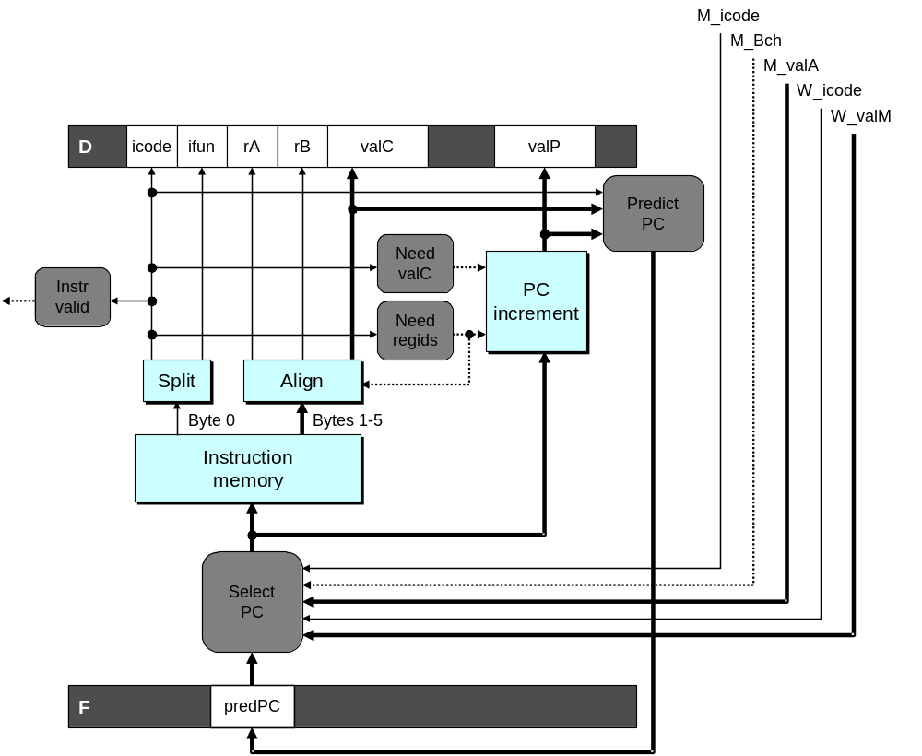
Fetch Logic Revisited
During Fetch Cycle
  Select PC
  Read bytes from instruction memory
  Examine icode to determine instruction length
  Increment PC
Timing
  Steps 2 & 4 require significant amount of time

Slide 43
Standard Fetch Timing
Select PC
need_regids, need_valC
Mem. Read
Increment
1 clock cycle
  Must Perform Everything in Sequence
  Can’t compute incremented PC until know how much to increment it by

Slide 44
A Fast PC Increment Circuit
incrPC
High-order 29 bits
Low-order 3 bits
MUX
carry
0
1
29-bit
incre-
menter
3-bit adder
Slow
Fast
need_regids
0
High-order 29 bits
need_ValC
Low-order 3 bits
PC
Notes:
因为指令长度为1-6个字节。所以大部分时间只有PC的低3位在变化。而高位很多时候是不变的。
利用这一性质。我们可以只加低3位。如果没有进位，那么高29位就直接输出，如果有进位，再加1。

Slide 45
Modified Fetch Timing
need_regids, need_valC
Select PC
3-bit add
Mem. Read
MUX
Incrementer
Standard cycle
1 clock cycle
29-Bit Incrementer
  Acts as soon as PC selected
  Output not needed until final MUX
  Works in parallel with memory read
Notes:
因为高29位的加一是一直在加的。即使最后没有被选中，它也会加。而且这个加法只依赖于Select PC的结果，不依赖于其他任务（比方说内存读取的完成）。

Slide 46
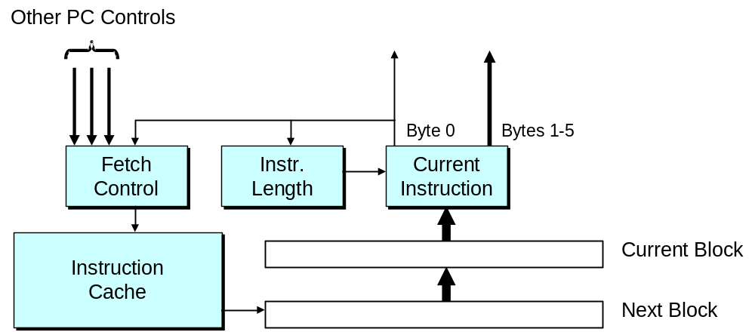
More Realistic Fetch Logic
Fetch Box
  Integrated into instruction cache
  Fetches entire cache block (16 or 32 bytes)
  Selects current instruction from current block
  Works ahead to fetch next block
    As reaches end of current block
    At branch target

